Slide 1
Session Tracking Mechanism – Hidden Form Field

Slide 2
What is hidden field?
hidden (invisible) textfield
used for maintaining the state of an user
Store the information in the hidden field and get it from another servlet
This approach is better if we have to submit form in all the pages and we don't want to depend on the browser.
Example
<input type="hidden" name="uname" value=“Sharan ">

Slide 3
Advantages & Disadvantages
Advantage of Hidden Form Field
It will always work whether cookie is disabled or not.
Disadvantage of Hidden Form Field:
It is maintained at server side
Extra form submission is required on each page
Only textual information can be used

Slide 4
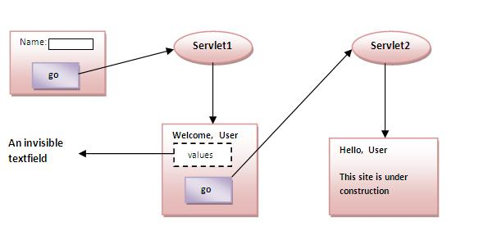
Example of Hidden Form Field

Slide 5
Hidden Form Example – web.xml
<servlet>
<servlet-name>s2</servlet-name>
<servlet-class>SecondServlet</servlet-class>
</servlet>
<servlet-mapping>
<servlet-name>s2</servlet-name>
<url-pattern>/servlet2</url-pattern>
</servlet-mapping>
</web-app>
<web-app>
<servlet>
<servlet-name>s1</servlet-name>
<servlet-class>FirstServlet</servlet-class>
</servlet>
<servlet-mapping>
<servlet-name>s1</servlet-name>
<url-pattern>/servlet1</url-pattern>
</servlet-mapping>

Slide 6
Hidden Form Example – FirstServlet
public class FirstServlet extends HttpServlet {
public void doGet(HttpServletRequest request, HttpServletResponse response){
try{
response.setContentType("text/html");
PrintWriter out = response.getWriter();
String n=request.getParameter("userName");
out.print("Welcome "+n);
//creating form that have invisible textfield
out.print("<form action='servlet2'>");
out.print("<input type='hidden' name='uname' value='"+n+"'>");
out.print("<input type='submit' value='go'>");
out.print("</form>");
out.close();
}catch(Exception e){System.out.println(e);}
}
}

Slide 7
Hidden Form Example – SecondServlet
import java.io.*;
import javax.servlet.*;
import javax.servlet.http.*;
public class SecondServlet extends HttpServlet {
public void doGet(HttpServletRequest request, HttpServletResponse response)
try{
response.setContentType("text/html");
PrintWriter out = response.getWriter();
//Getting the value from the hidden field
String n=request.getParameter("uname");
out.print("Hello "+n);
out.close();
}catch(Exception e){System.out.println(e);}
}
}

Slide 8
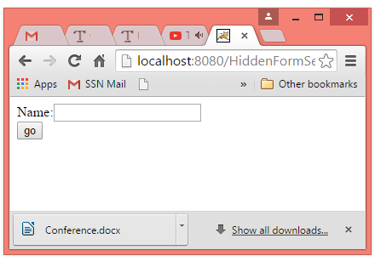
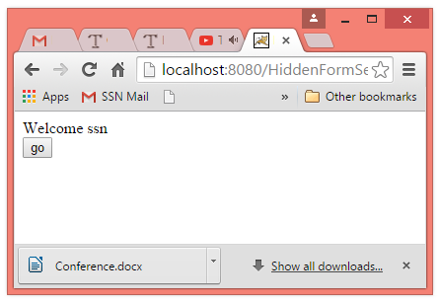
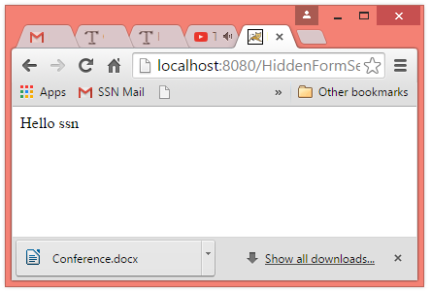
Hidden Form Example – Output
Index.html
<form action="servlet1">
Name:<input type="text" name="userName"/><br/>
<input type="submit" value="go"/>
</form>

